Slide 1
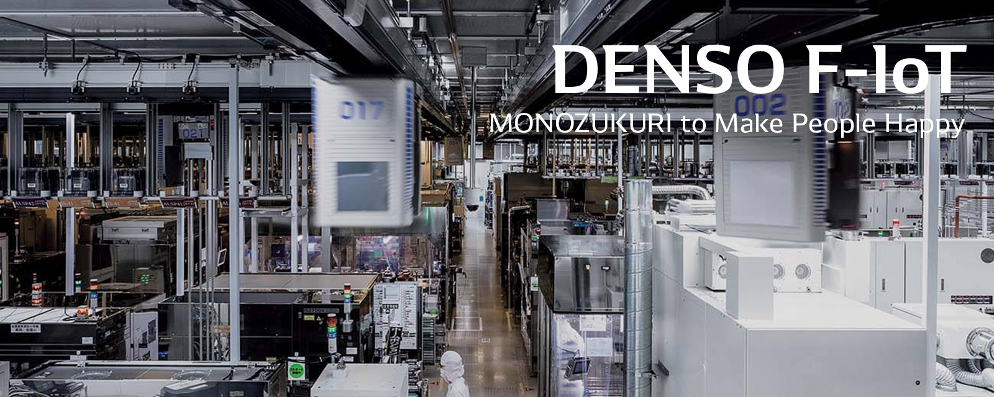

E-PCR
Log In
Log In

Slide 2
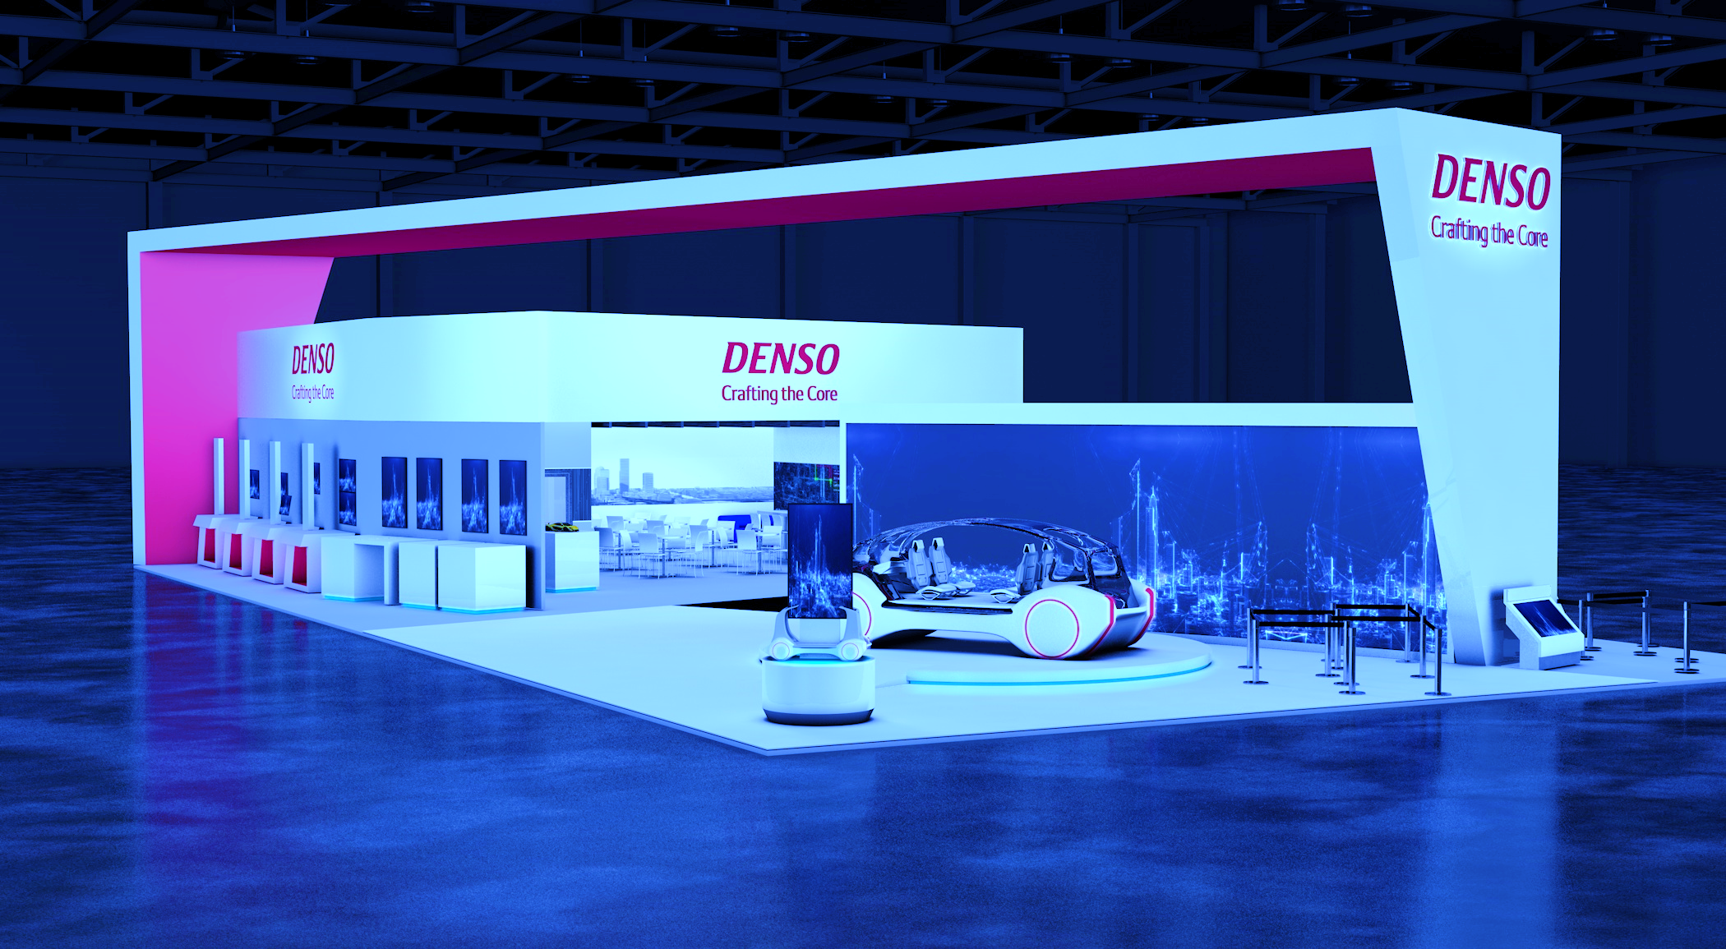

E-PCR
Log In

Slide 3
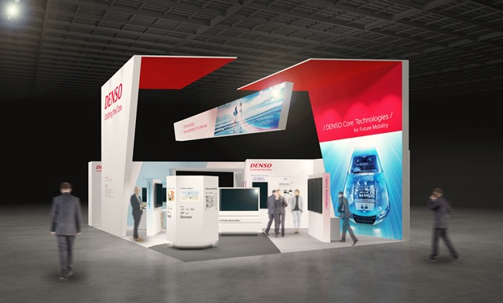
E-PCR
Log In

Slide 4

Username
Password
E-PCR
Remember me
Login
Forgot Password / ID Employee ?
Log In
Log In

Slide 5
Username
Password
E-PCR
Remember me
Login
Forgot Password / ID Employee ?
Log In

Slide 6
Username
Password
E-PCR
Remember me
Login
Forgot Password / ID Employee ?
Log In

Slide 7




Process Change Report System
Change Process
Approval
Report
Change Process
Change Process
Show
10
entires
Search :
No
Product name
Title
Rank
Customer submission
PIC
Leadtime
Status
Action
1
xxxxxx
xxxx
x
xxxx
x
Normal
On process
2
xxxxxx
xxxx
x
xxxx
x
Normal
Achieved

Slide 8
Process Change Report System
Change Process
Approval
Report
STEP 1
STEP 2
STEP 3
Readtime :
Normal
Urgent
Create Date :
22/07/2020
Annual Plan :
Annual Plan item
Additional item
Annual Plan No :
xxxxxxxx
Department / Section :
Production Engineer
Registant :
MS.Kittiya Yangsao
No.(Automatic) :
PCR-DPE-FYXX-AXXX
Title :
xxxxxxxx
Judgement Rank :
xxxxxxxx
Change type :
xxxxxxxx
Customer submission:
Yes
No
Customer name:
xxxxxxxx
Planning review:
Yes
No
NEXT

Slide 9
Process Change Report System
Change Process
Approval
Report
sds
STEP 1
STEP 2
STEP 3
Details of Change
Product :
HP3
G2S
G4S-i
PCV
SCV
Supplier/Process :
(Only PCR Supplier)
xxxxxxxx
HP5S
G3S
G4.5S-i
PRV
Filter
Change point :
xxxxxxxx
HP5E
G4S
Rail
Solenoid
GD-P3S
GD-P3H
UC
SIFS
Other
Output :
xxxxxxxx
Internal process :
xxxxxxxx
SC Point *:
S
F
E
C
Parts name:
xxxxxxxx
S
F
E
C
Parts number:
S
F
E
C
xxxxxxxx
Other
( )
PREVIOUS
NEXT

Slide 10

Process Change Report System
Change Process
Approval
Report
STEP 1
STEP 2
STEP 3
Details of Process Change
Existing Process | Proposed Process | Characeristics values affected/Remark
PREVIOUS
NEXT

Slide 11

Process Change Report System
Change Process
Approval
Report
STEP 1
STEP 2
STEP 3
Implementation plan :
1 ) Re – organizing processes
Start
Plan :
Actual :
2 ) Surverying process capability
Start
Plan :
Actual :
3 ) Preparing standard document
Start
Plan :
Actual :
PREVIOUS
NEXT

Slide 12
Process Change Report System
Change Process
Approval
Report
STEP 1
STEP 2
STEP 3
4 ) PFMEA/QA Network
Yes
No
Start
Plan :
Actual :
5 ) PCC Concerning
Yes
No
Start
Plan :
Actual :
6 ) Production started date
Start
Plan :
Actual :
PREVIOUS
NEXT

Slide 13

Process Change Report System
Change Process
Approval
Report
STEP 1
STEP 2
STEP 3
7 ) Other;(Safety,Environment,BKD,etc)
Start
Plan :
Actual :
Need attachments :
1 .PFMEA
4 .Standardize work, WI
2 .QA Network
5 .Standardize work, WI
3 .Control plan ,PCC
6 .Process flow chart
7 .Other
PREVIOUS
NEXT

Slide 14
Process Change Report System
Change Process
Approval
Report
STEP 1
STEP 2
STEP 3
Approve plan :
Prepared :
Date :
PE Checker :
Date :
PE Approver :
Date :
QA Checker :
Date :
QA Approver :
Date :
PREVIOUS
SUBMIT

Slide 15
Process Change Report System
Change Process
Approval
Report
STEP 1
STEP 2
STEP 3
STEP 4
Annual Plan No :
xxxxxxxx
Create Date :
22/07/2020
Department / Section :
Production Engineer
Change type :
xxxxxxxx
Registant :
xxxxxxxx
Judgement Rank :
xxxxxxxx
No.(Automatic) :
Would you like to Submit ?
PCR-DPE-FYXX-AXXX
Assy name :
Product group :
Diesel
Gasoline
SKD
Other
Parts Name :
xxxxxxxx
Title :
xxxxxxxx
Parts Number :
xxxxxxxx
Cancel
Send
Supplier / Process :
xxxxxxxx
PREVIOUS
NEXT

Slide 16
Process Change Report System
Change Process
Approval
Report
Change Process
Change Process
Show
10
entires
Search :
No
Product name
Title
Rank
Customer submission
PIC
Leadtime
Status
Action
1
xxxxxx
xxxx
x
xxxx
x
Normal
On process
2
xxxxxx
xxxx
x
xxxx
x
Normal
On process
3
xxxxxx
xxxx
x
xxxx
x
Urgent
Achieved

Slide 17
Process Change Report System
Change Process
Approval
Report
Change Process
Supatchai kamaporn
Change Process
Position : Trainee
Department : PE
Show
10
entires
Search :
Close
Log out
No
Product name
Title
Rank
Customer submission
PIC
Leadtime
Status
Action
1
xxxxxx
xxxx
x
xxxx
x
Normal
On process
2
xxxxxx
xxxx
x
xxxx
x
Normal
Achieved
3
xxxxxx
xxxx
x
xxxx
x
Urgent
Achieved

Slide 18
Process Change Report System
Change Process
Approval
Report
Change Process
Details
Issue No. 111
Change Process
Readtime :
Normal
Annual Plan No : 21
Department / Section :
Registant :
MS.Kittiya Yangsao
Show
10
entires
Production Engineer
Search :
No.(Automatic) :
PCR-DPE-FYXX-AXXX
Title :
xxxxxxxx
No
Product name
Title
Rank
Customer submission
PIC
Leadtime
Status
Action
Judgement Rank :
xxxxxxxx
Change type :
xxxxxxxx
On process
1
xxxxxx
xxxx
x
xxxx
x
Normal
Customer submission:
Yes
Customer name:
xxxxxxxx
2
xxxxxx
xxxx
x
xxxx
x
Product :
Normal
Achieved
Planning review:
Yes
HP3
HP5S
Internal process :
xxxxxxxx
Supplier/Process :
(Only PCR Supplier)
xxxxxxxx
xxxxxx
xxxx
x
xxxx
x
Urgent
3
Change point :
xxxxxxxx
Achieved

Slide 19
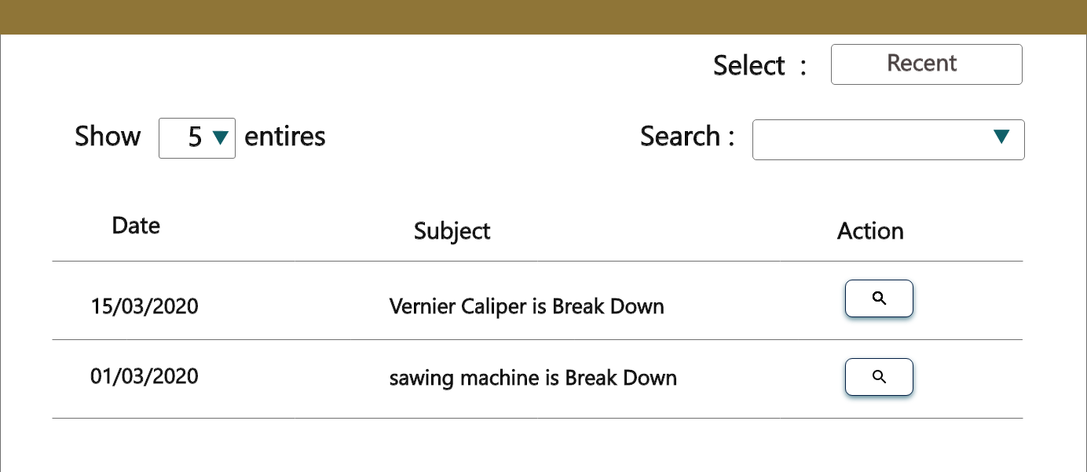


Process Change Report System
Change Process
Approval
Report
Change Process
Details
Change Process
Parts name:
xxxxxxxx
Output :
xxxxxxxx
Parts number:
xxxxxxxx
SC Point *:
S
Details of Process Change :
Approve plan :
Prepared : xxxxxxxx
QA Checker : xxxxxxx
PE Checker : xxxxxxx
QA Approver :
PE Approver : xxxxxx
Close

Slide 20

Process Change Report System
Change Process
Approval
Report
Status subject : Vernier caliper is break down
Plan Date Sign
Result Date Sign
Prepare By
Kanyarat Rodtong
10-07-20 09.00
Prepare By
Kanyarat Rodtong
10-07-20 09.00
Checked By
Patcharaporn Intana
10-07-20 10.00
Checked By
Patcharaporn Intana
10-07-20 10.00
Approved By
Kittiya Yangsao
12-07-20 11.00
Approved By
Kittiya Yangsao
12-07-20 11.00
Quality Assurance Dept.
Anapat Rodtong
13-07-20 10.00
Quality Assurance Dept.
Anapat Rodtong
13-07-20 10.00
Complete
13-07-20 10.00
Complete
13-07-20 10.00

Slide 21
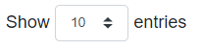
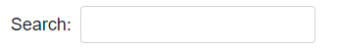
Process Change Report System
Change Process
Approval
Report
Please select a department
Please select year
Report
No. | Number Change | Subject | Date start | Date finished
1 | xxxxxxxx | xxxxxxxx | 20/10/2020 | 25/10/2020
2 | xxxxxxxx | xxxxxxxx | 20/10/2020 | 25/10/2020
3 | xxxxxxxx | xxxxxxxx | 20/10/2020 | 25/10/2020
4 | xxxxxxxx | xxxxxxxx | 20/10/2020 | 25/10/2020

Slide 22
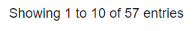

Process Change Report System
Change Process
Approval
Report
Report
5 | xxxxxxxx | xxxxxxxx | 19/10/2020 | 25/10/2020
6 | xxxxxxxx | xxxxxxxx | 19/10/2020 | 25/10/2020
7 | xxxxxxxx | xxxxxxxx | 19/10/2020 | 25/10/2020
8 | xxxxxxxx | xxxxxxxx | 19/10/2020 | 25/10/2020
9 | xxxxxxxx | xxxxxxxx | 19/10/2020 | 25/10/2020
10 | xxxxxxxx | xxxxxxxx | 19/10/2020 | 25/10/2020

Slide 23
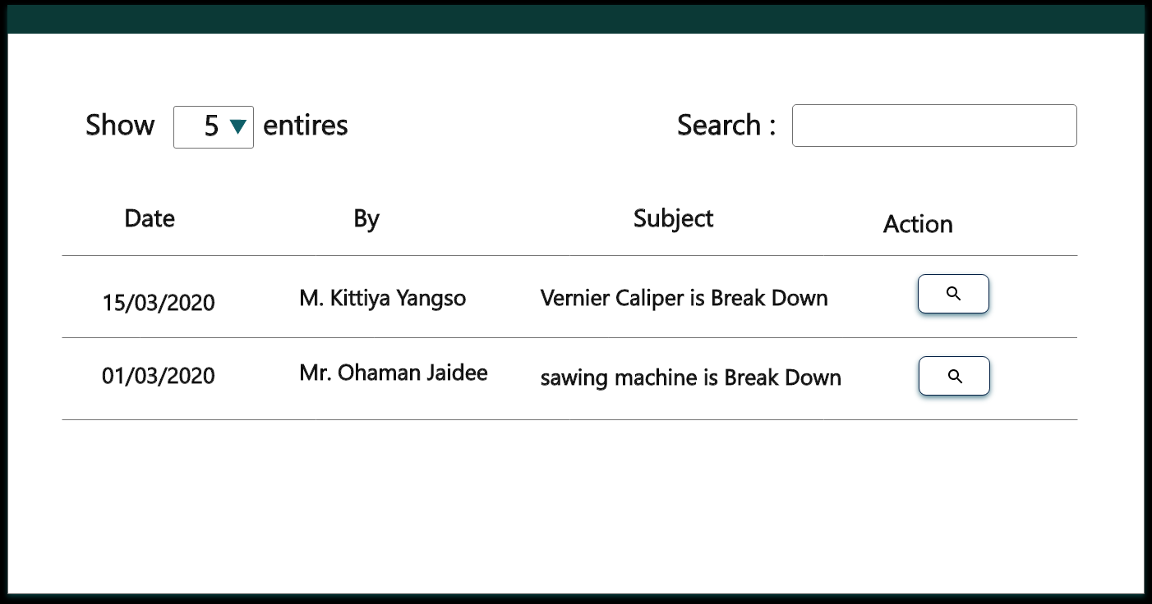
Process Change Report System
Change Process
Approval
Report
Approval

Slide 24


Process Change Report System
Change Process
Approval
Report
Approval
Issue No. 111
Annual plan no. 21
Change Type : New
Part name : Vernier Caliper
Checking Point : modify machine
Part number : 2365
Checking Point : modify machine
Subject : Vernier Break Down
Reason : Break Down
Process : Inspection

Slide 25


Process Change Report System
Change Process
Approval
Report
Approval
Issue No. 111
Annual plan no. 21
Change Type : New
Would you like to Approve?
Part name : Vernier Caliper
Checking Point : modify machine
Part number : 2365
Checking Point : modify machine
Subject : Vernier Break Down
Reason : Break Down
Process : Inspection

Slide 26
Process Change Report System
Change Process
Approval
Report
Approval
Issue No. 111
Annual plan no. 21
Change Type : New
Part name : Vernier Caliper
Checking Point : modify machine
Part number : 2365
Checking Point : modify machine
Subject : Vernier Break Down
Reason : Break Down
Process : Inspection

Slide 27
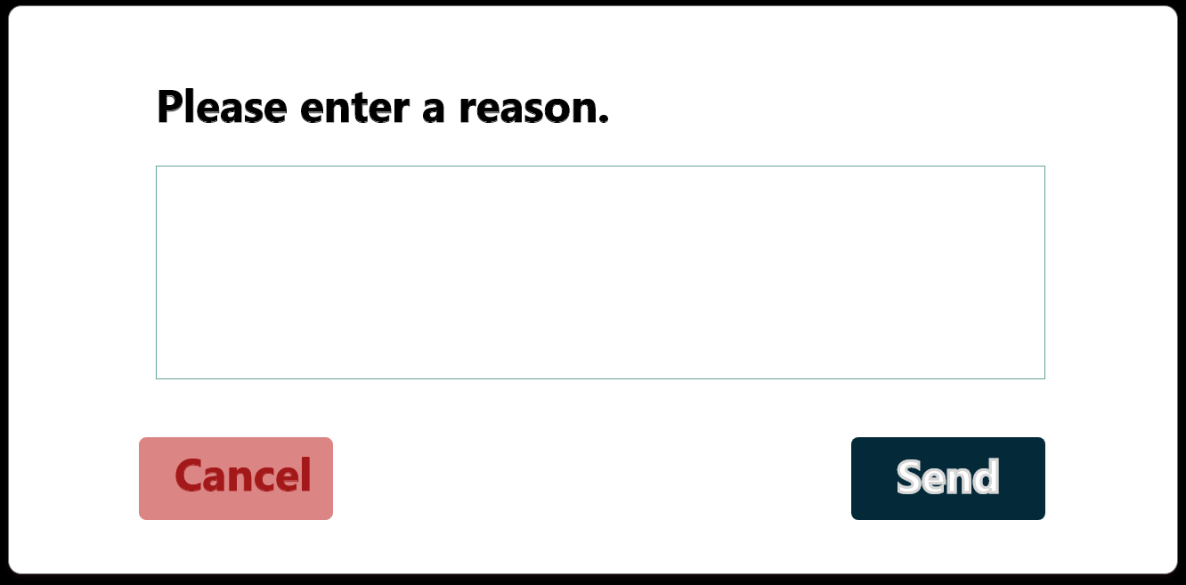
Process Change Report System
Change Process
Approval
Report
Process Change Report
Issue No. 111
Annual plan no. 21
Change Type : New
Part name : Vernier Caliper
Checking Point : modify machine
Part number : 2365
Checking Point : modify machine
Subject : Vernier Break Down
Reason : Break Down
Process : Inspection

Slide 28
Process Change Report System
Change Process
Approval
Report
Process Change Report
Issue No. 111
Annual plan no. 21
Change Type : New
Part name : Vernier Caliper
Checking Point : modify machine
Part number : 2365
Checking Point : modify machine
Subject : Vernier Break Down
Reason : Break Down
Process : Inspection

Slide 29
Process Change Report System
Change Process
Approval
Report
QA

Slide 30
Process Change Report System
Change Process
Approval
Report
STEP 1
STEP 2
STEP 3
QA Customer Input
Customer Approval :
Apply
Don’t Apply
Waiting confirm
Customer Name :
Review meeting :
Planning review
Part Examination
Process Explanation
Process Examination
Total Review
QA Meeting
Judge by (QA Incharge) :
Approver (QA GM up) :
PREVIOUS
Submit

Slide 31
Process Change Report System
Change Process
Approval
Report
STEP 1
STEP 2
STEP 3
Progress status :
Status :
During preparation
Plan completed
Cancelled
Planning review :
Plan :
Actual :
PIC :
Report–Minute - Other :
Part examination :
Actual :
PIC :
Report–Minute - Other :
Process explanation :
Actual :
PIC :
Report–Minute - Other :
PREVIOUS
Submit
Part examination :
PE Approver :
Date :
QA Checker :
Date :
QA Approver :
Date :

Slide 32
Process Change Report System
Change Process
Approval
Report
STEP 1
STEP 2
STEP 3
Process presentation :
Actual :
PIC :
Report–Minute - Other :
Total review meeting :
Actual :
PIC :
Report–Minute - Other :
Total follow meeting :
Actual :
PIC :
Report–Minute - Other :
Approval Coucil meeting :
Actual :
PIC :
Report–Minute - Other :
PREVIOUS
Submit
Process presentation :
Total review meeting :
Total follow meeting :
PE Approver :
Date :
QA Checker :
Date :
QA Approver :
Date :

Slide 33
Process Change Report System
Change Process
Approval
Report
STEP 1
STEP 2
STEP 3
Start / Changing data (SOP) :
Actual :
PIC :
Report–Minute - Other :
PCR Cancel :
Actual :
PIC :
Report–Minute - Other :
Other evidence :
Attachment changing point control sheet and meeting material etc.
PREVIOUS
Submit
Process presentation :
Total review meeting :
Total follow meeting :
PE Approver :
Date :
QA Checker :
Date :
QA Approver :
Date :

Slide 34
Process Change Report System
Change Process
Approval
Report
STEP 1
STEP 2
STEP 3
QA Planning Input
Status :
Annual Plan item
Additional item
Annual / Revise plan :
Annual plan review
Revise plan review
Date :
PIC :
Require / Comment :
PREVIOUS
Submit

Slide 35
Process Change Report System
Change Process
Approval
Report
STEP 1
STEP 2
STEP 3
QA Planning Input
Status :
Annual Plan item
Additional item
Annual / Revise plan :
Would you like to Submit ?
Annual plan review
Revise plan review
Date :
PIC :
Require / Comment :
PREVIOUS
Submit

Slide 36
Process Change Report System
Change Process
Approval
Report
Approval
Issue No. 111
Annual plan no. 21
Change Type : New
Part name : Vernier Caliper
Checking Point : modify machine
Part number : 2365
Checking Point : modify machine
Subject : Vernier Break Down
Reason : Break Down
Process : Inspection

Slide 37
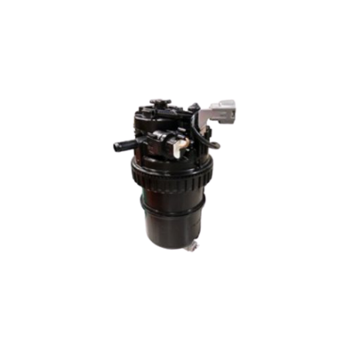


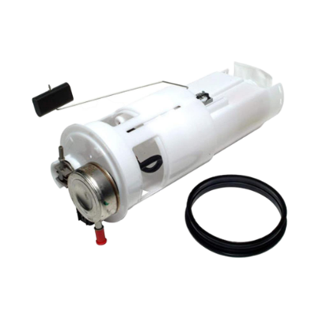
Process Change Report System
Change Process
Approval
Report
Admin
Setting Form
Report
Setting user
SDM
SKD
SUPPLIER

Slide 38
Process Change Report System
QA Planning
QA planning
Date :
21/07/2020
Planning review meeting result
Chairman :
Report :
Minute/Other :
Choose files
6 step meeting
Part Examination
Process Examination
Quality report
Shipment Review
Process Explanation
Total Review
QA Meeting

Slide 39
Process Change Report System
BKD CHECK
BKD CHECK
BKD CHECK
Require
Not Require
More request :

